Slide 1

Basics of DBMS

Slide 2

What is Database

Slide 3


Expectation from DBMS
Concurrency

Slide 4
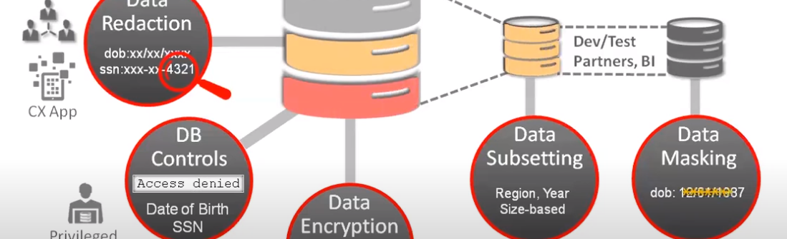

Expectation from DBMS Security

Slide 5
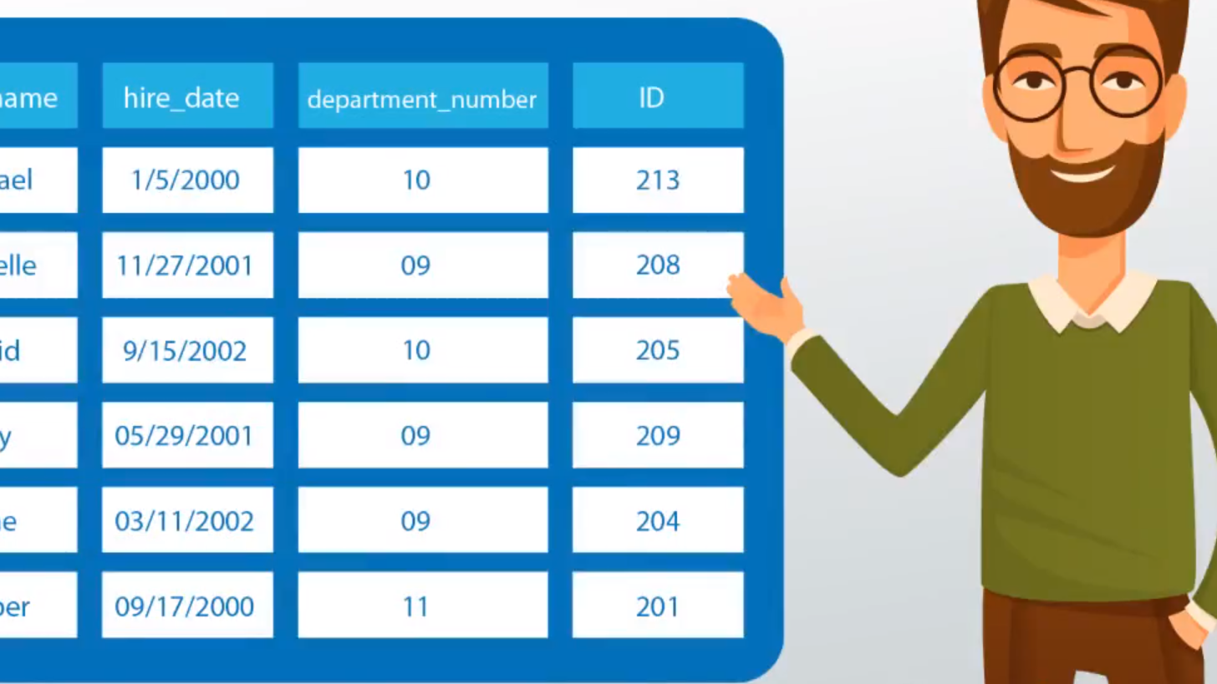
Expectation from DBMS Accessibility

Slide 6
History of DBMS

Slide 7
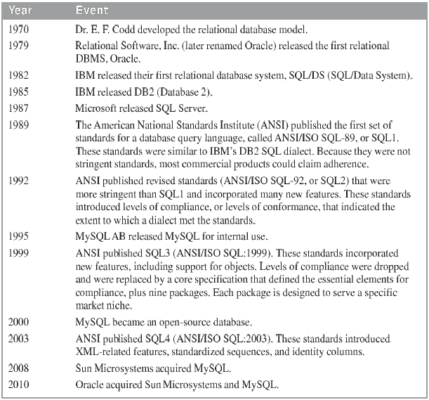
Facts

Slide 8
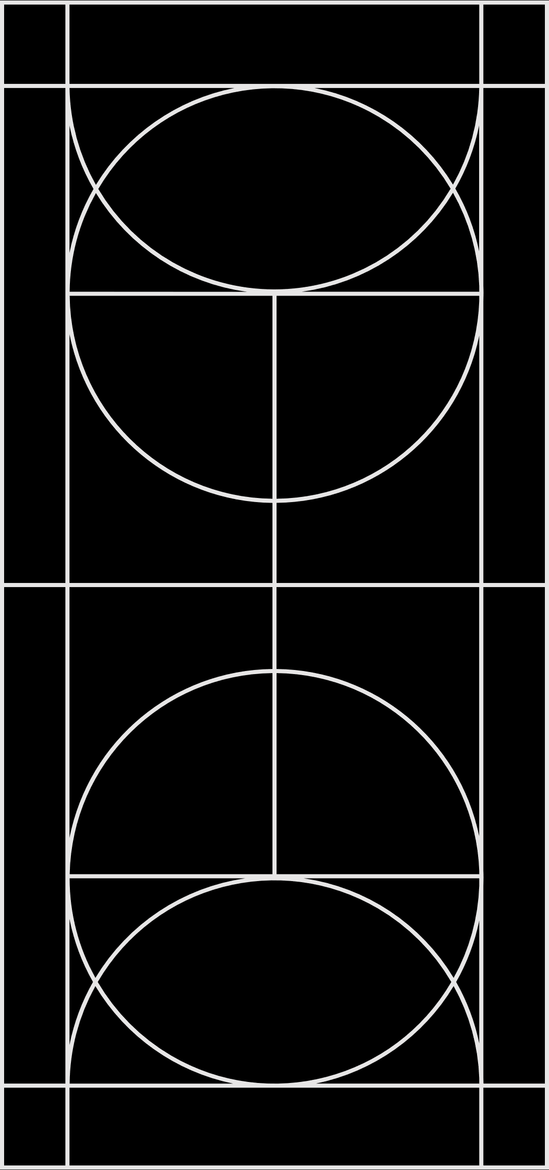
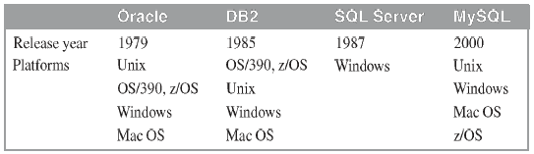
Comparison

Slide 9
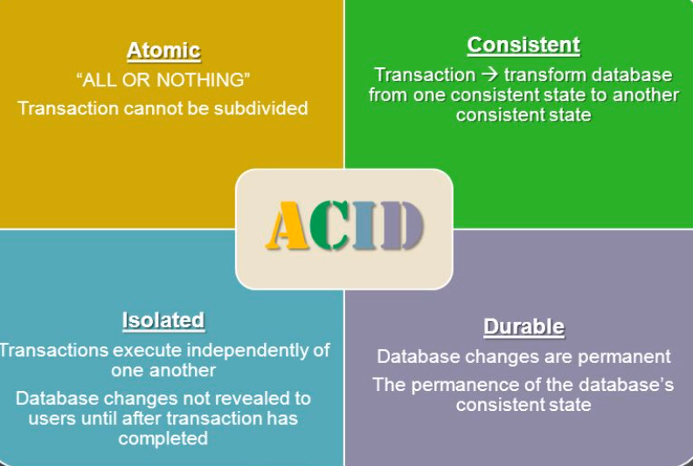
Important Transaction Related

Slide 10
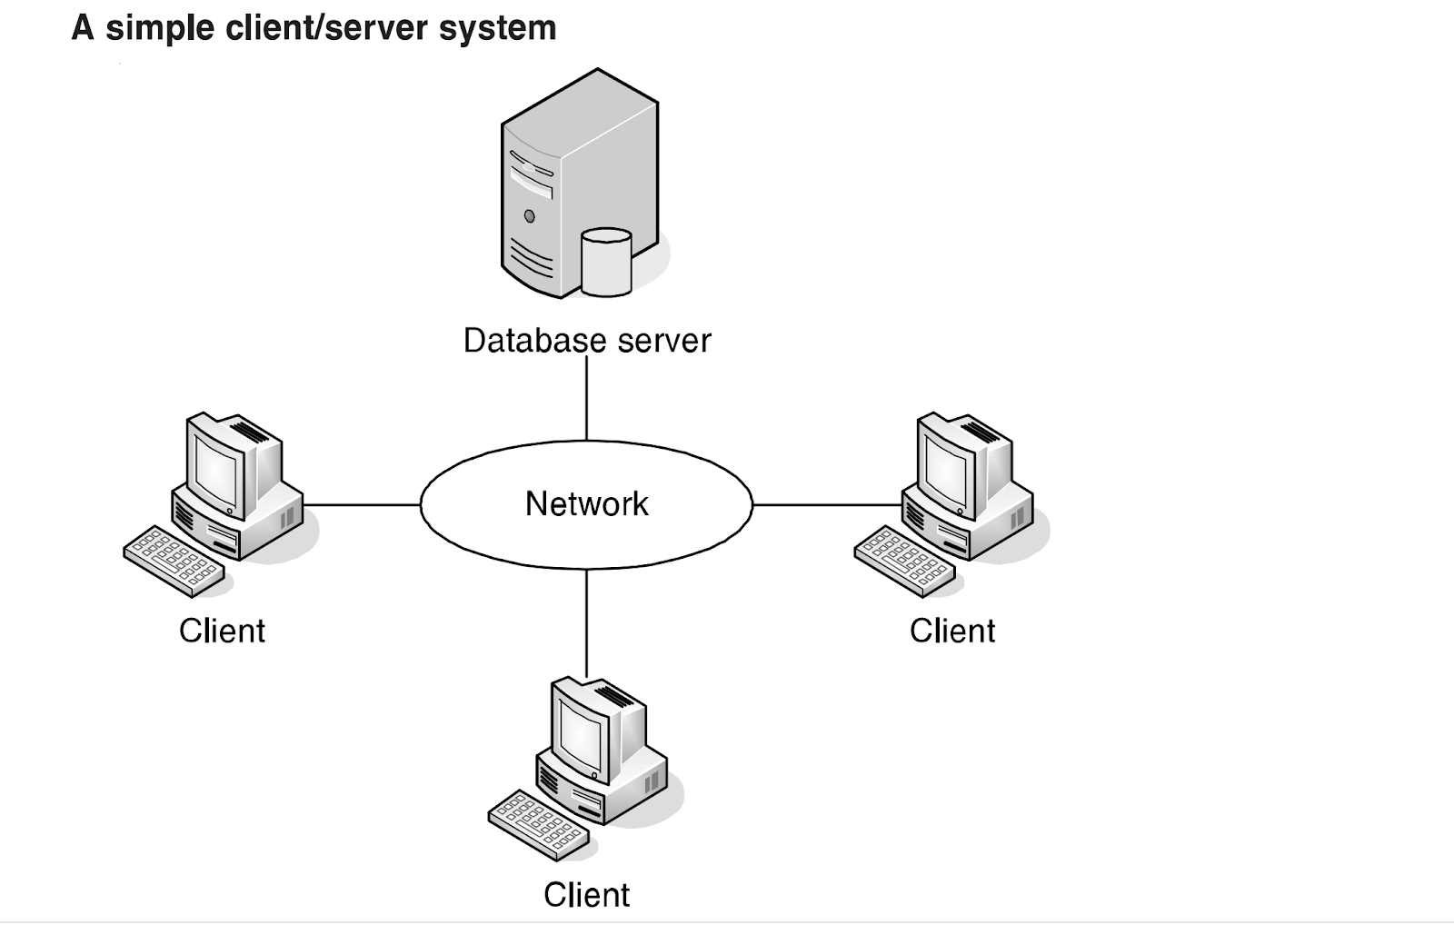
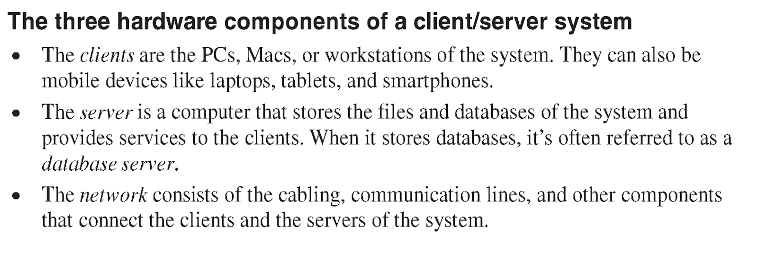
CLIENT SERVER SYSTEM

Slide 11
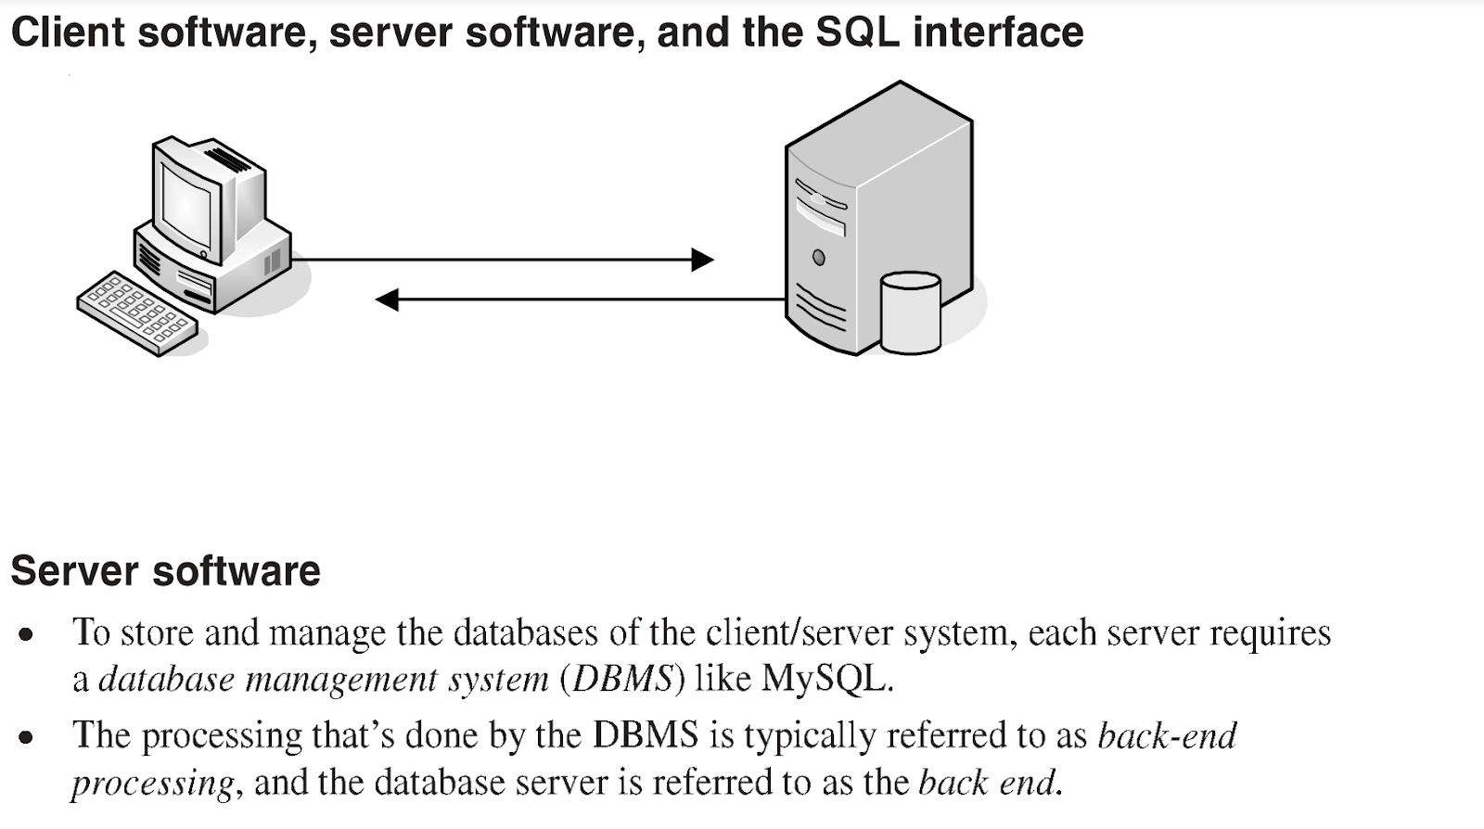
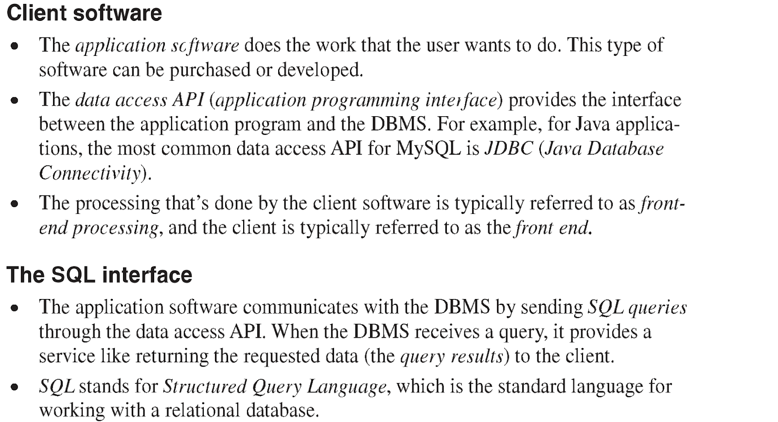
Software Component Of a Client/Server System

Slide 12
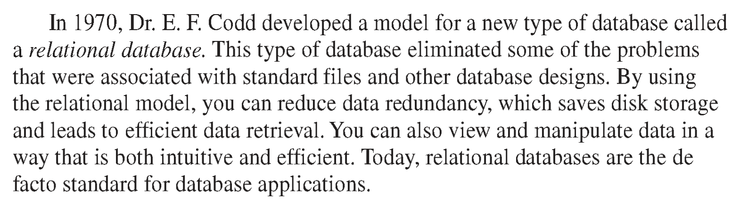
Introduction to the relational database model

Slide 13
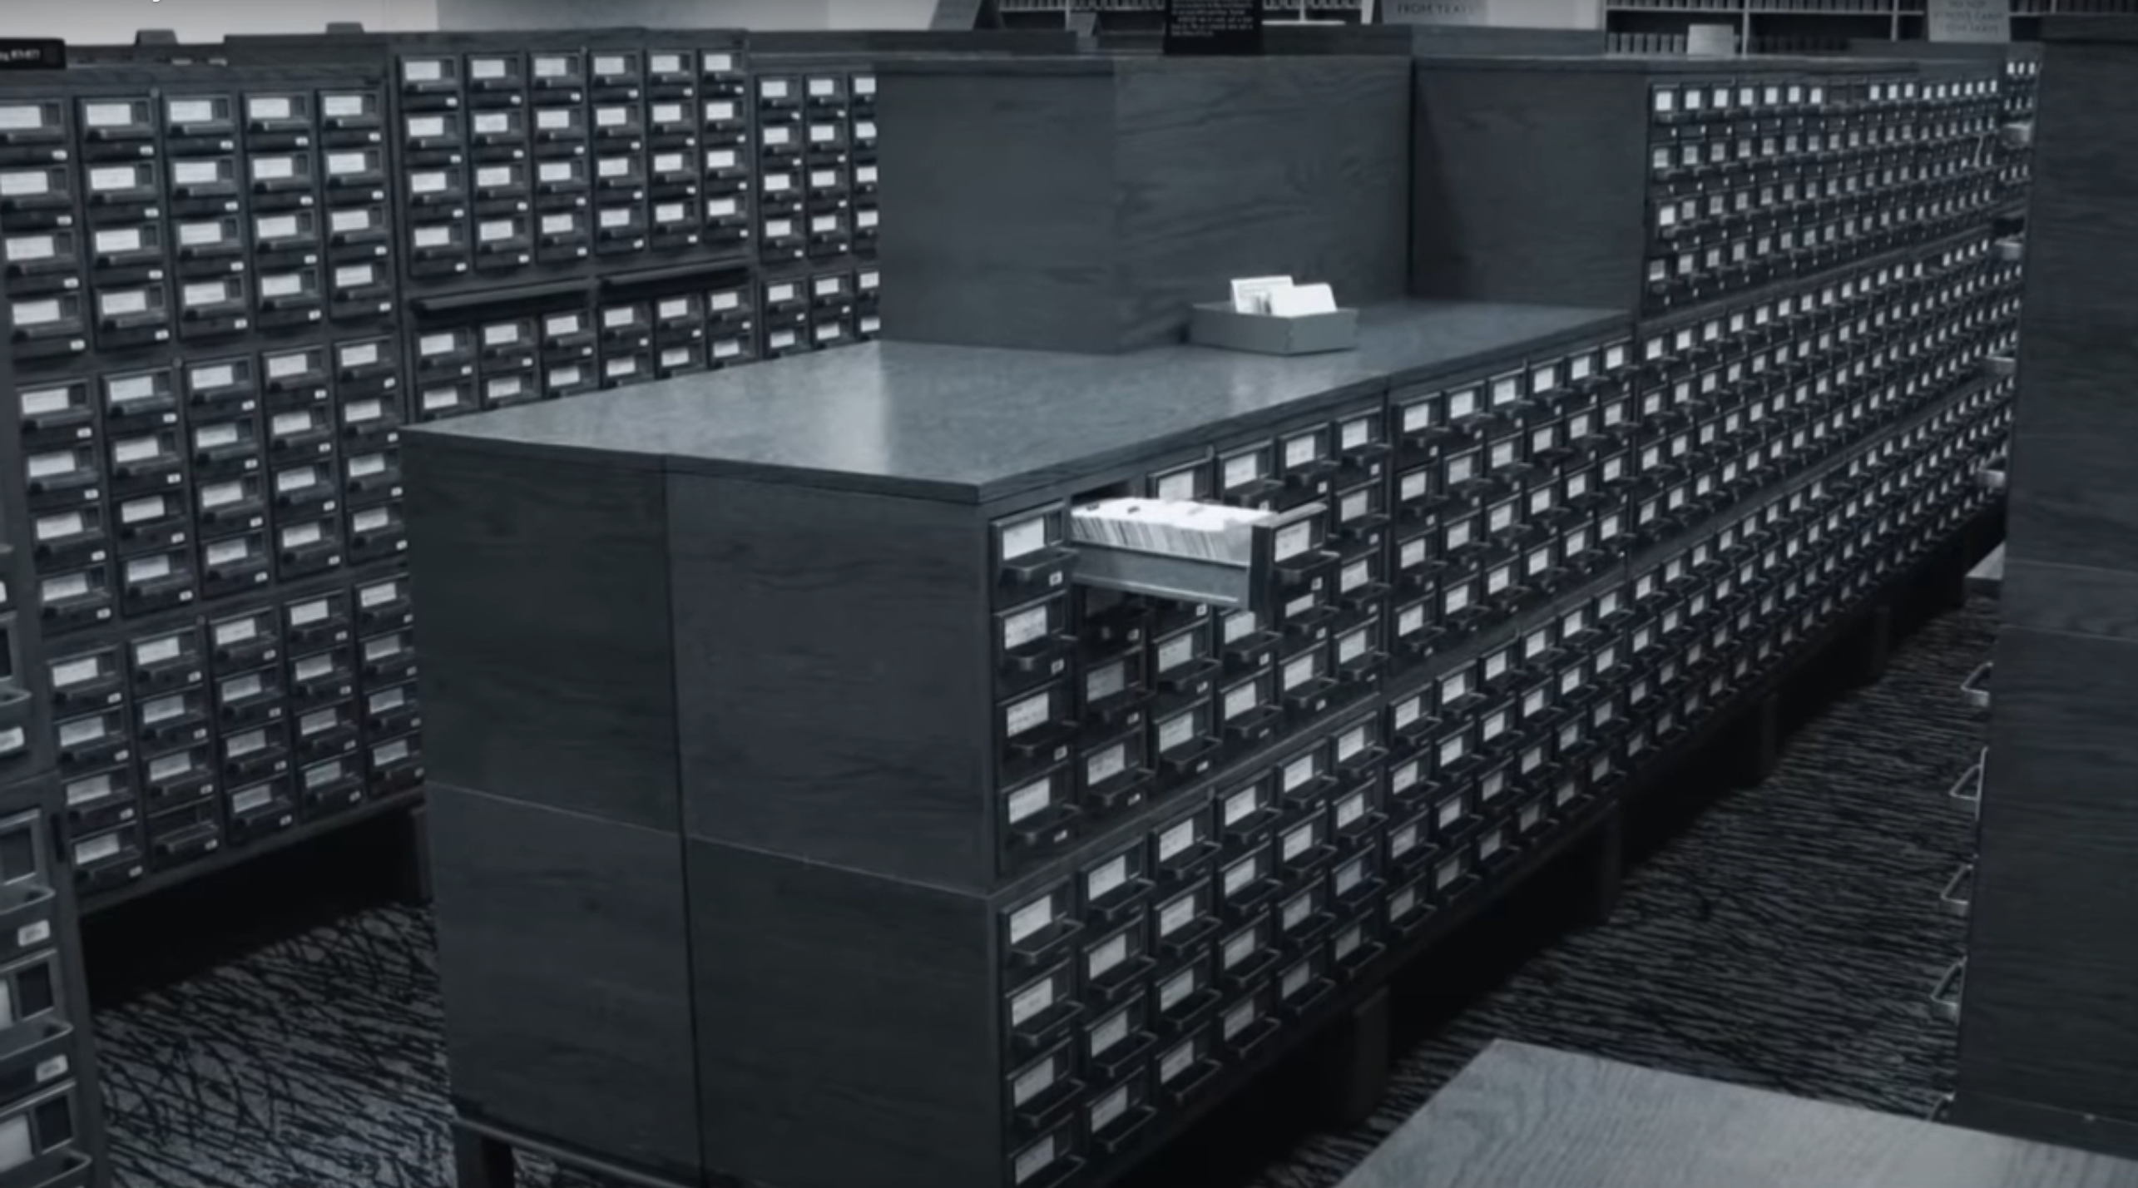
How the Data Store :-

Slide 14
Codd’s Rules
These rules can be applied on any database system that manages stored data using only its relational capabilities. This is a foundation rule, which acts as a base for all the other rules.
Rule 1: Information Rule
The data stored in a database, may it be user data or metadata, must be a value of some table cell. Everything in a database must be stored in a table format.
Rule 2: Guaranteed Access Rule
Every single data element (value) is guaranteed to be accessible logically with a combination of table-name, primary-key (row value), and attribute-name (column value). No other means, such as pointers, can be used to access data.
Rule 3: Systematic Treatment of NULL Values
The NULL values in a database must be given a systematic and uniform treatment. This is a very important rule because a NULL can be interpreted as one the following − data is missing, data is not known, or data is not applicable.
Rule 4: Active Online Catalog
The structure description of the entire database must be stored in an online catalog, known as data dictionary, which can be accessed by authorized users. Users can use the same query language to access the catalog which they use to access the database itself.
Rule 5: Comprehensive Data Sub-Language Rule
A database can only be accessed using a language having linear syntax that supports data definition, data manipulation, and transaction management operations. This language can be used directly or by means of some application. If the database allows access to data without any help of this language, then it is considered as a violation.

Slide 15
Rule 6: View Updating Rule
All the views of a database, which can theoretically be updated, must also be updatable by the system.
Rule 7: High-Level Insert, Update, and Delete Rule
A database must support high-level insertion, updation, and deletion. This must not be limited to a single row, that is, it must also support union, intersection and minus operations to yield sets of data records.
Rule 8: Physical Data Independence
The data stored in a database must be independent of the applications that access the database. Any change in the physical structure of a database must not have any impact on how the data is being accessed by external applications.
Rule 9: Logical Data Independence
The logical data in a database must be independent of its user’s view (application). Any change in logical data must not affect the applications using it. For example, if two tables are merged or one is split into two different tables, there should be no impact or change on the user application. This is one of the most difficult rule to apply.
Rule 10: Integrity Independence
A database must be independent of the application that uses it. All its integrity constraints can be independently modified without the need of any change in the application. This rule makes a database independent of the front-end application and its interface.
Rule 11: Distribution Independence
The end-user must not be able to see that the data is distributed over various locations. Users should always get the impression that the data is located at one site only. This rule has been regarded as the foundation of distributed database systems.
Rule 12: Non-Subversion Rule
If a system has an interface that provides access to low-level records, then the interface must not be able to subvert the system and bypass security and integrity constraints.

Slide 16
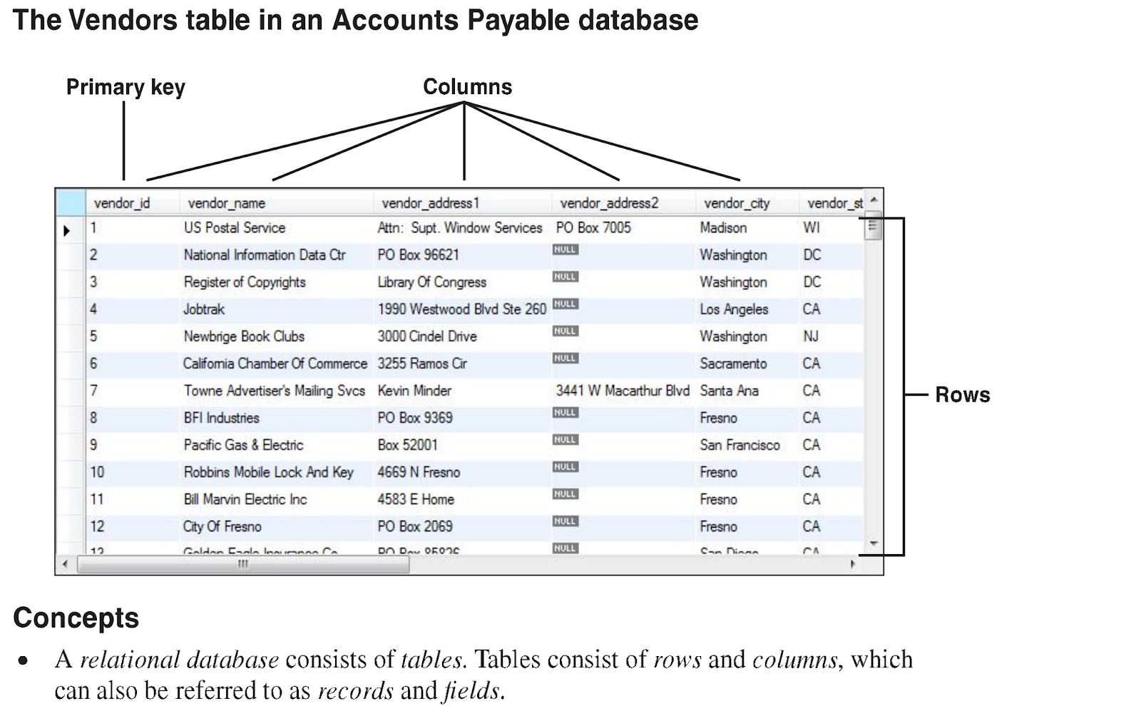
Basics of relational database
Table
Rows / Records
Columns / Fields

Slide 17
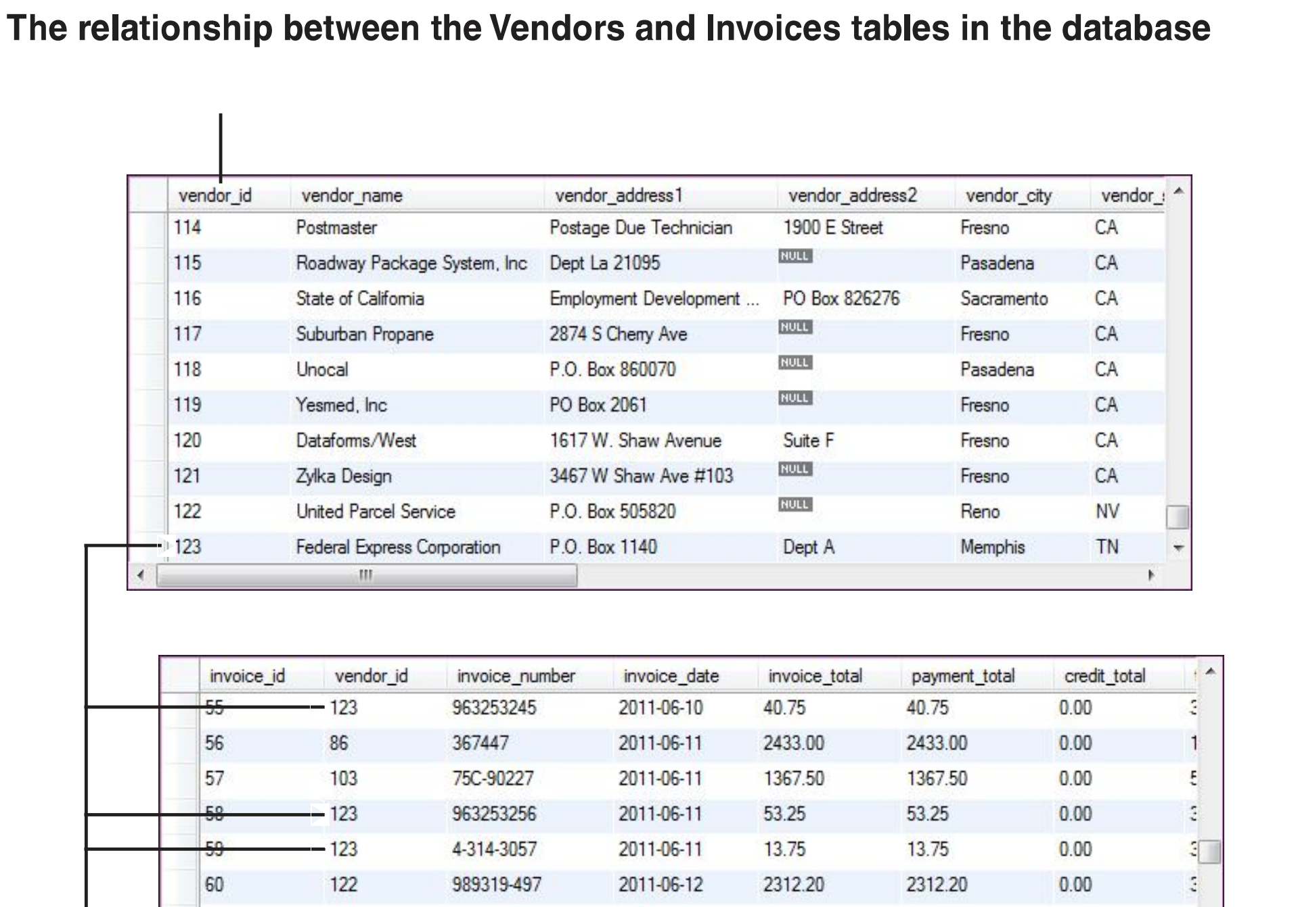
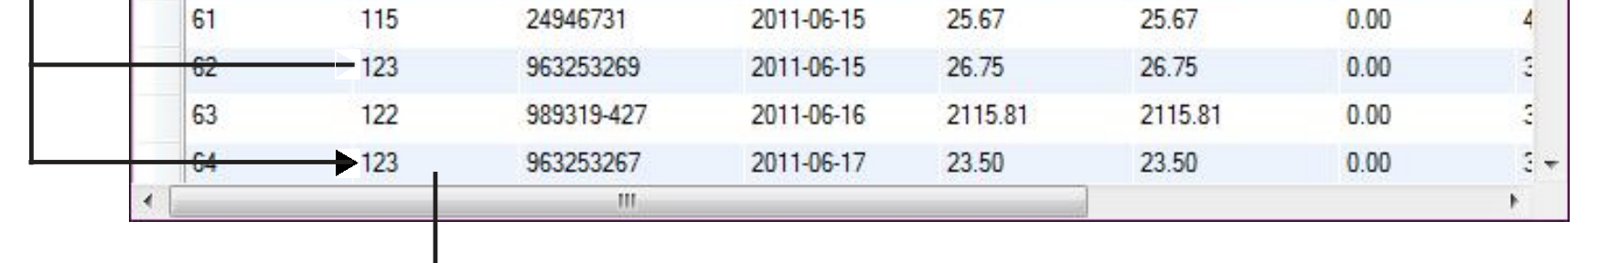
Relation between two tables

Slide 18
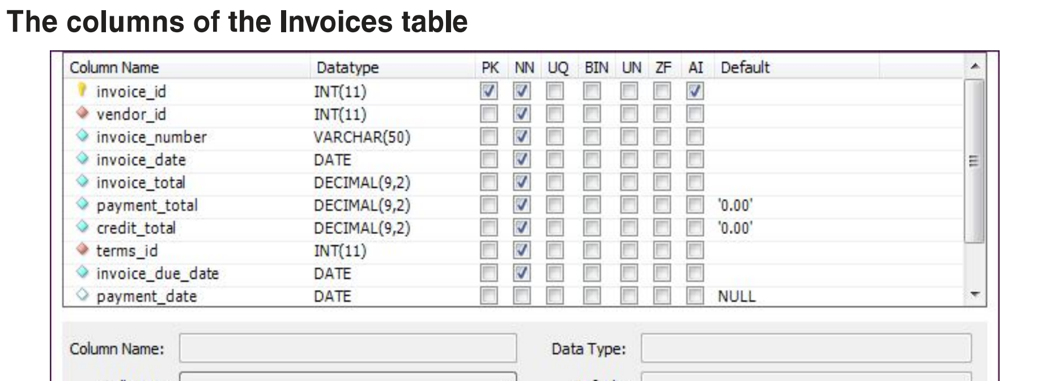
Columns
Also called as attribute
Contains the single datatype of values
May have different definition attached to it
Table may contain different columns with different columns definition

Slide 19
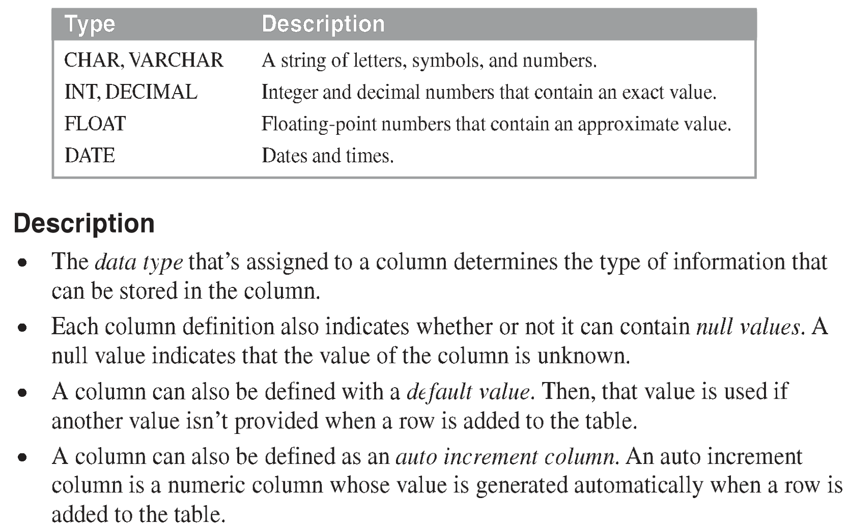
Data Types

Slide 20
Datatypes
Divided into three subgroups
Numeric Type
Used to store Number
Various Numeric Type like
TINYINT – A very small integer (-128 to 127)
SMALLINT – (-32768 to 32767)
MEDIUMINT – (-8388608 to 8388607)
INT – (-2147483648 to 2147483647)
BIGINT – (-9223372036854775808 to 9223372036854775807)
DEC(M,D) – DEC(4,2)
FLOAT(5,2)
Date and Time
Used to store dates
Default format of date : YYYY-MM-DD HH:MM:SS
Various Dates
DATE
DATETIME
TIMESTAMP
String
CHAR
VARCHAR
TEXT

Slide 21
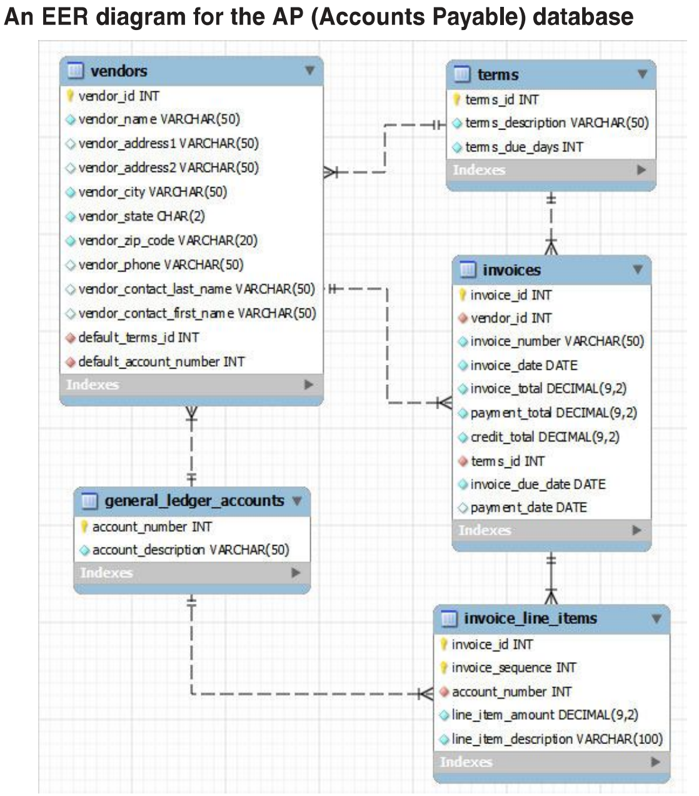
How My Database Looks Like

